Slide 1

Brain Tumor Segmentation Using U-Net

Slide 2
Agenda
Introduction
Literature review
Methodology
Visualization
Data Augmentation
Results
Conclusion

Slide 3
Introduction
Objective:
To design and implement a deep learning system for automatic segmentation of brain tumors from MRI scans using a U-Net model.
Applications include Clinical diagnosis assistance, radiotherapy planning, treatment monitoring.
Motivation:
Manual segmentation is time-consuming and subjective. Automation improves speed, consistency, and precision.

Slide 4
Literature Review
Brain Tumor Segmentation : Traditionally performed using manual contouring or semi-automated methods like thresholding and region growing. These methods are prone to inconsistency and heavily depend on radiologist expertise.
Segmentation Approach : Recent shift from classical machine learning (e.g., SVMs, Random Forests) to deep learning models like Convolutional Neural Networks (CNNs), especially U-Net, which offers pixel-level accuracy and works well with limited labeled data.
Existing Systems : While U-Net and its variants show promising results, challenges remain in segmenting small tumors, handling imbalanced datasets, and generalizing across diverse MRI scan settings and modalities.
Gaps Identified:
Difficulty in accurately segmenting small or low-contrast tumor regions.
Trade-offs between segmentation accuracy and model inference time, especially for real-time or clinical deployment.

Slide 5
Methodology
Data Collection:
Collected a dataset of brain MRI scans with various modalities
Each image is accompanied by an annotated mask identifying tumor regions.
Data includes diverse samples across different patients, tumor types, and anatomical variations.
Preprocessing:
Images and masks were resized to a consistent resolution.
Normalized pixel values to improve model convergence.
Tumor Segmentation:
Implemented a U-Net architecture using TensorFlow for semantic segmentation.
Key features of the model:
1. Encoder-decoder structure with skip connections.
2. Multiple convolutional layers with ReLU activation and MaxPooling.

Slide 6
3. Transposed convolutions (up-sampling) in the decoder for precise localization.
4. Final output layer uses a sigmoid activation to produce a binary mask.
Training :
Used Dice loss as the loss function.
Optimizer: Adam
Validation split with learning rate reduction on plateau used to manage training stability.
Evaluation Metrics :
Accuracy: Percentage of correctly classified pixels.
Precision and Recall: Evaluate the segmentation quality specifically for tumor regions.
IoU (Intersection over Union): Measures prediction overlap with ground truth.

Slide 7
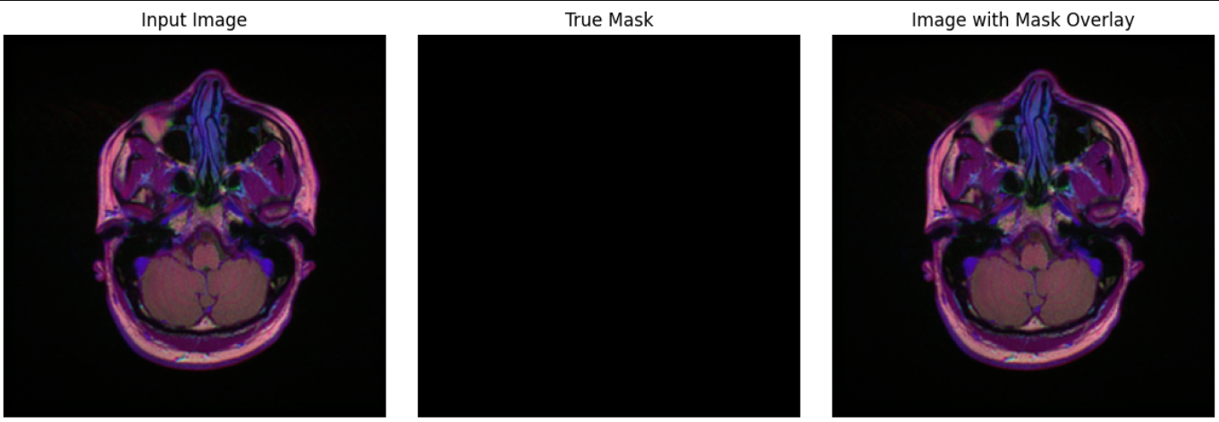
Visualization
This image illustrates a brain MRI slice used in a medical image segmentation task. The left panel shows the original input image, while the center panel displays a true mask, which is completely black—indicating no labeled region of interest in this slice. The right panel overlays the mask on the input image; since the mask is empty, it appears identical to the original, confirming that no segmentation was needed or applied here.

Slide 8
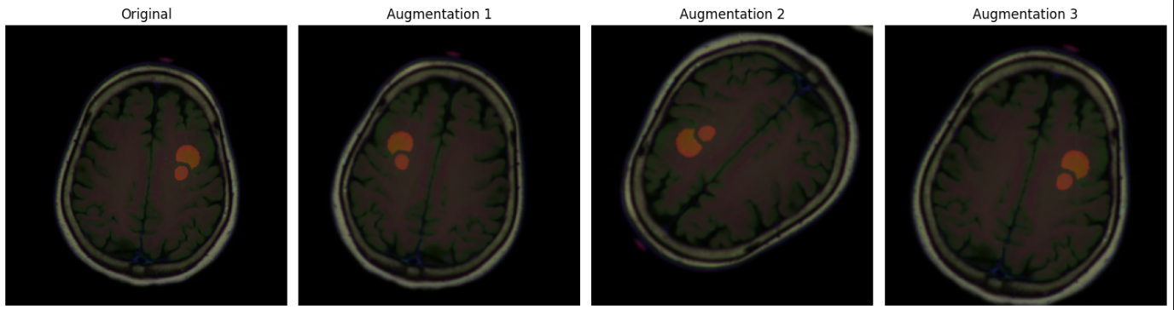
Data Augmentation
This image showcases a brain MRI scan with tumor segmentation and its augmented versions. The original image highlights the tumor in orange, while the augmentations apply transformations like rotation or scaling to simulate data variation. Such augmentations enhance model robustness by exposing it to diverse examples during training.

Slide 9
Results
Performance Metrics:
Tumor segmentation :
Test accuracy : 90.57%.
Train accuracy: 96.90%.
Model Evaluation:
Effective at distinguishing tumor regions from surrounding tissues.
Some segmentation errors observed in edge cases.
Visual Results:
Displayed side by side comparisons of original MR images, ground truth masks and predicted masks.
Qualitative results show good overlap between predicted tumor areas and actual ground truth.
Challenges:
Model performance may drop for very small or irregularly shaped tumors.
Generalization could be affected by variations in image quality or contrast.

Slide 10

Conclusion
The project demonstrates the potential of
combining medical imaging techniques with deep
learning (U-Net Architecture) for effective brain
tumor segmentation.
While results are promising, including high segmentation accuracy, further refinements are needed for robust deployment in clinical or real world healthcare settings.

Slide 11
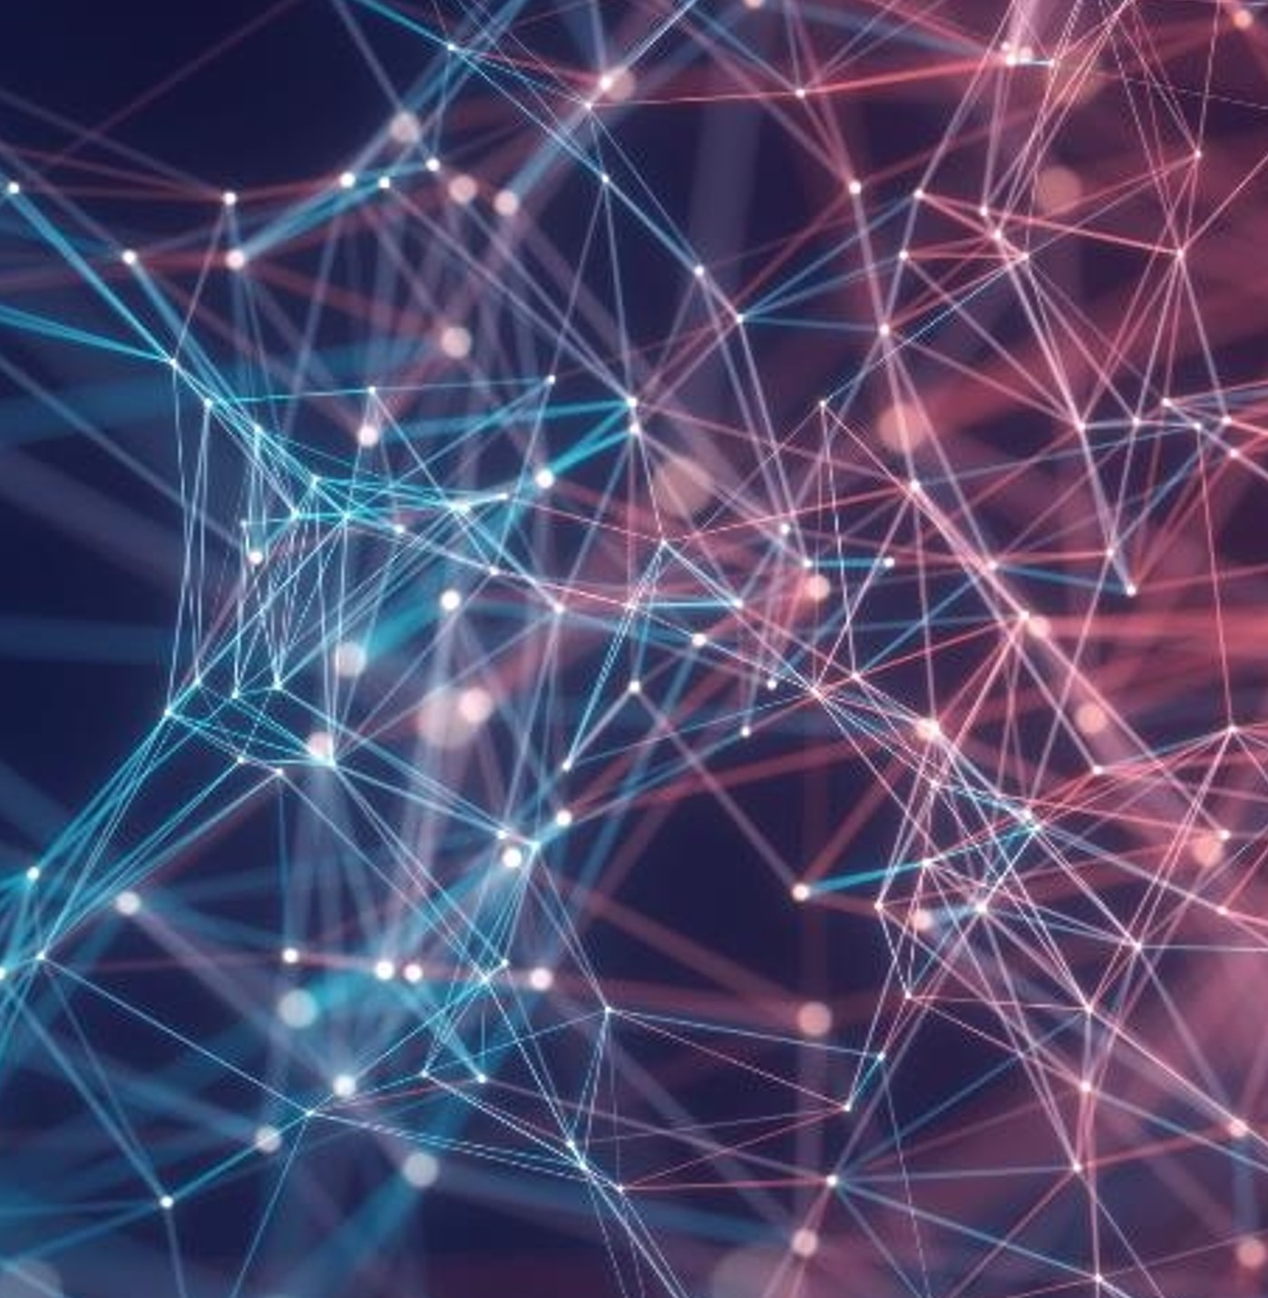
Thank you
Alukanti Srinidhi – B220675CS
Gundlapalli Padmapriya – B220308CS
Tangi Sowmya – B221253CS

